Slide 1




T-CloudDisk: A Tunable Cloud Storage Service for Flexible Batched Synchronization
Zhenhua Li *, Tsinghua University
He Xiao, Tsinghua University
Linsong Cheng *, Tsinghua University
Zhen Lu, Tsinghua University
Jian Li, Tsinghua University
Christo Wilson, Northeastern University
Yao Liu, Binghamton University
Yunhao Liu, Tsinghua University
Yafei Dai, Peking University
{lizhenhua1983, chengls48}@gmail.com
http://www.greenorbs.org/people/lzh/

Slide 2
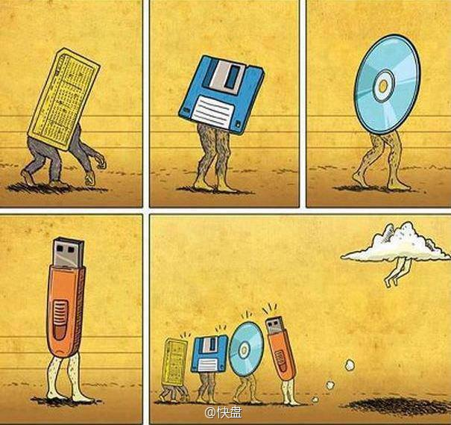
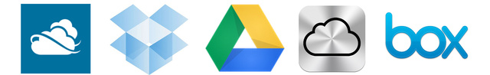





Cloud Storage Service
Enabled by Cloud Computing & Internet Broadband
Extremely popular in recent years
SkyDrive: 200 M users
Dropbox: 100 M users
Google Drive: numerous …
Apple iCloud: countless …
Box.com: 14 M users
Notes:
节点，可以大到一个数据中心，也可以小到一部手机、一个传感器、一个电子标签。

Slide 3
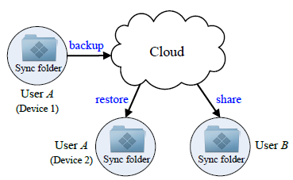




The Same Target
Provide Internet users with a convenient & reliable solution to store and share data
From anywhere, on any device, at any time
Notes:
节点，可以大到一个数据中心，也可以小到一部手机、一个传感器、一个电子标签。

Slide 4
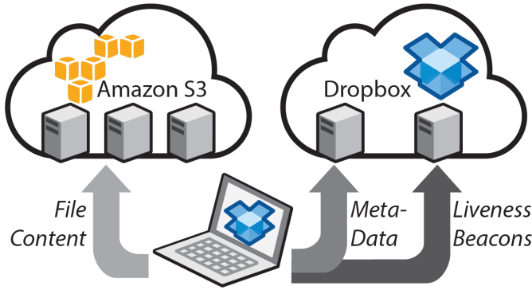
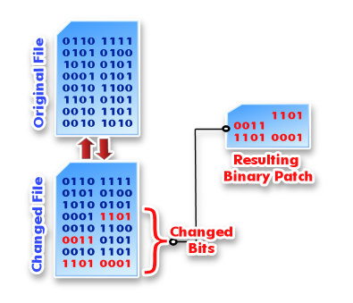

Dropbox is the Market Leader
- Over 100 M users who store/update 1 billion files per day!
- In average, $4.8 revenue per user every year
How can Dropbox compete with so many market giants?
_{Delta sync}
_{+ compression}
_{= Saving traffic}
Easy scalability & high reliability

Slide 5
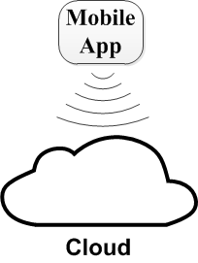
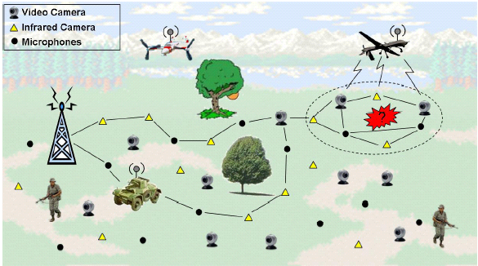

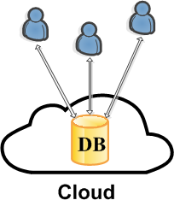


So, I rely on Dropbox more and more
To do a lot of advanced things
Periodical data collecting
Collaborative document editing
Database hosting
File download
(directly)
Frequent, short data updates !

Slide 6
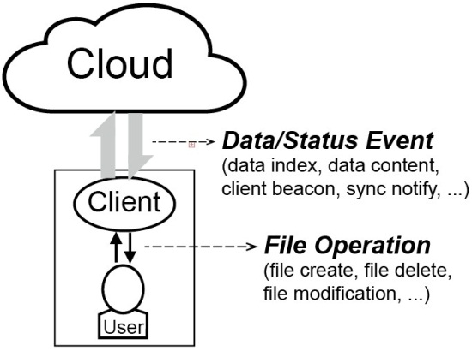
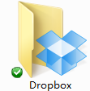
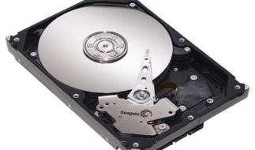
But, this time Dropbox let me down …
For example: periodically collect 1 MB of data
2 MB?
5 MB?
10 MB?
1 MB
Internet
45 MB
Frequent, short data updates
time
Session maintenance traffic far exceeds real data update size
Network traffic for data synchronization
The Traffic Overuse Problem

Slide 7
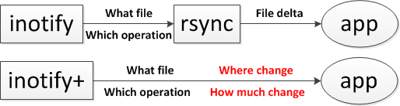
Deep Understanding of Dropbox
How does the Dropbox client work?
We use “strace dropbox” on top of Linux
And meanwhile record the communication packets
to figure out the working principle of Dropbox client
Traffic & Computation

Slide 8
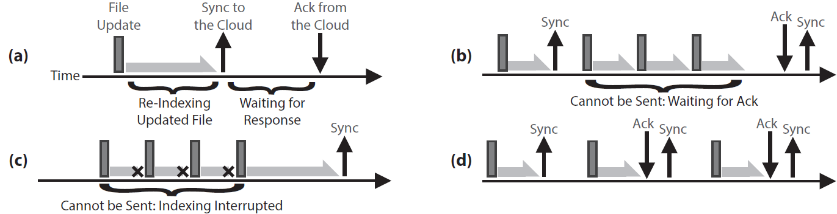
Working Principle of Dropbox Client
The four basic components of Dropbox client behavior
First, Dropbox client must re-index the updated file --- computation intensive
A file is considered “synchronized” to the cloud only when the cloud returns ACK
This is why some data updates are “batched” for synchronization unintentionllay
Sometimes, when data updates happen even faster than the file re-indexing speed, they are also “batched” for synchronization

Slide 9
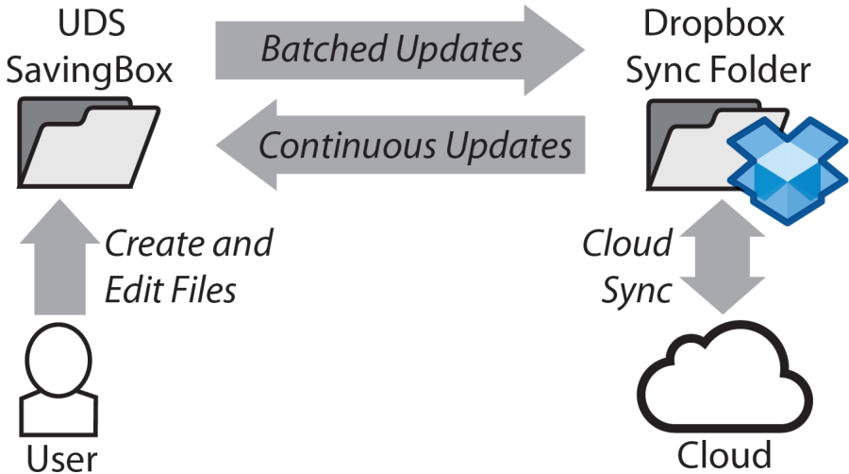
UDS middleware
Given that batched sync can effectively save traffic …
- Why not intentionally perform batched sync?
Update-batched Delayed Sync
- Set a middlebox and a byte counter for the batched updates
- Frequent, short updates are batched in a controlled manner
9

Slide 10
The story is not over yet …
UDS has two potential shortcomings:
Middleware consumes extra CPU and memory resources
Middlebox costs extra storage space
10

Slide 11
Drawback of Our Research
Black-box measurement and middleware solution are very insufficient
What happens after the data packet dives into the cloud?
“Google Drive, SkyDrive and Dropbox do have problems. But have you considered the problems from a system design/tradeoff perspective?”

Slide 12
So the T-CloudDisk project started …
We are re-developing a small-scale Dropbox from scratch, with internal UDS implementation
Independent service, not middleware
Tunable back-end cloud (S3, Aliyun OSS, Openstack Swift, …)
Flexible batched synchronization

Slide 13
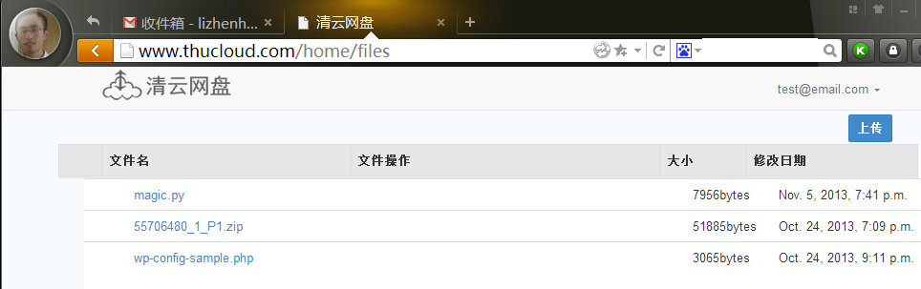


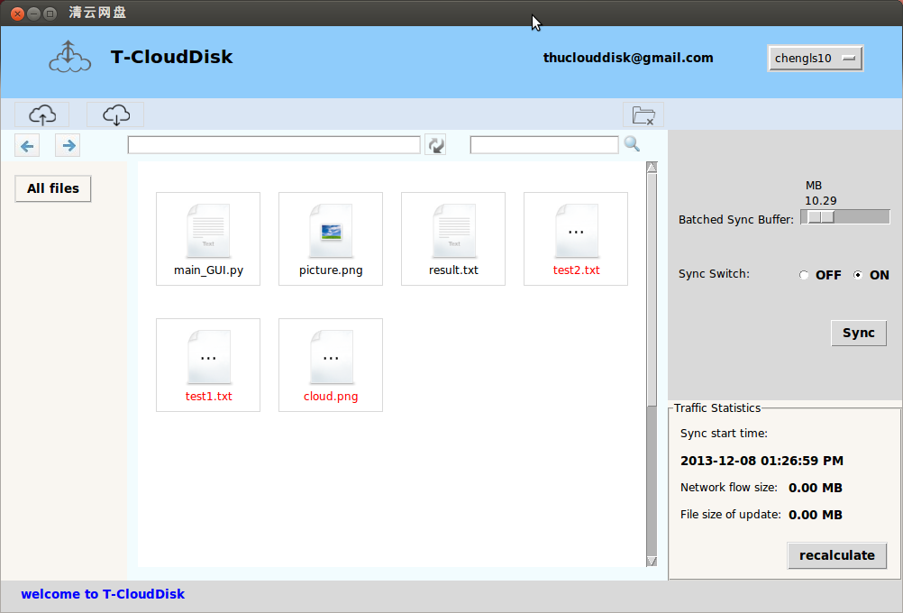


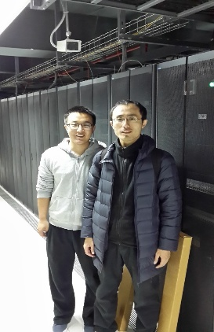
http://www.thucloud.com

Slide 14
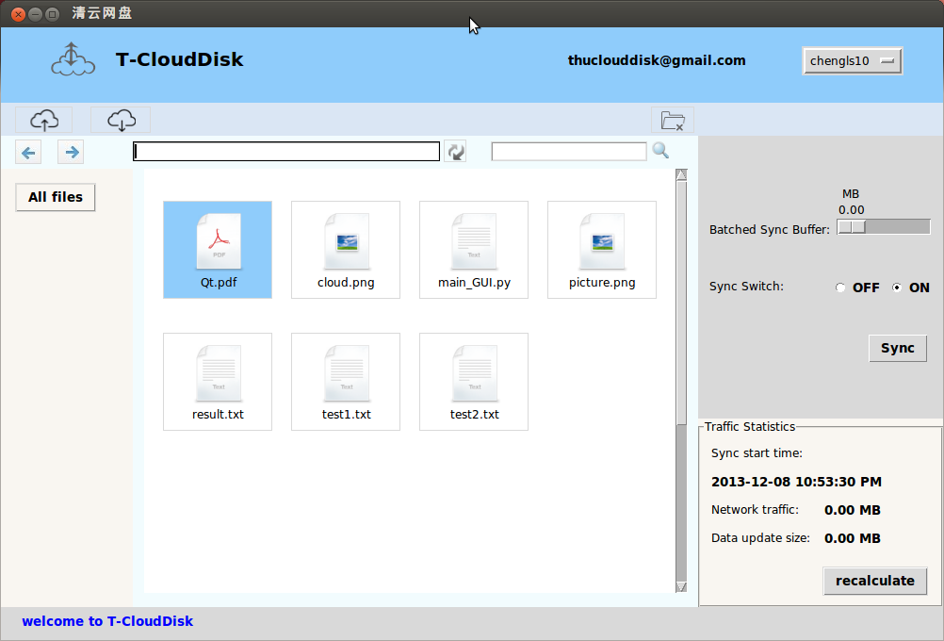
Basic file operations
Download file
Delete file
Upload file
Select a file

Slide 15
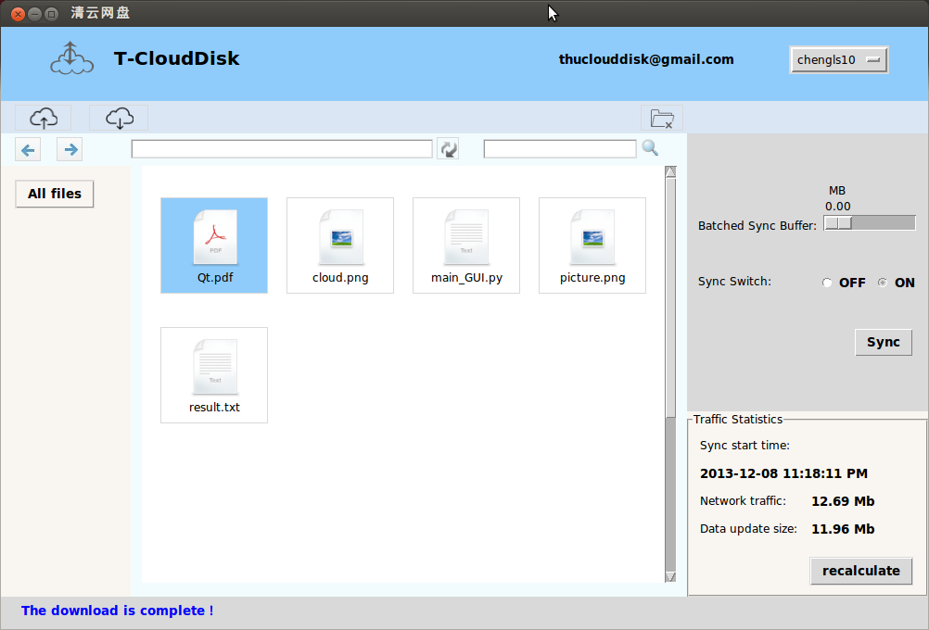
Traffic Statistics
Here is the
Network traffic
Here is the
Data update size
After you upload or download files
The selected file
Click this button
to recalculate
This is the status bar

Slide 16
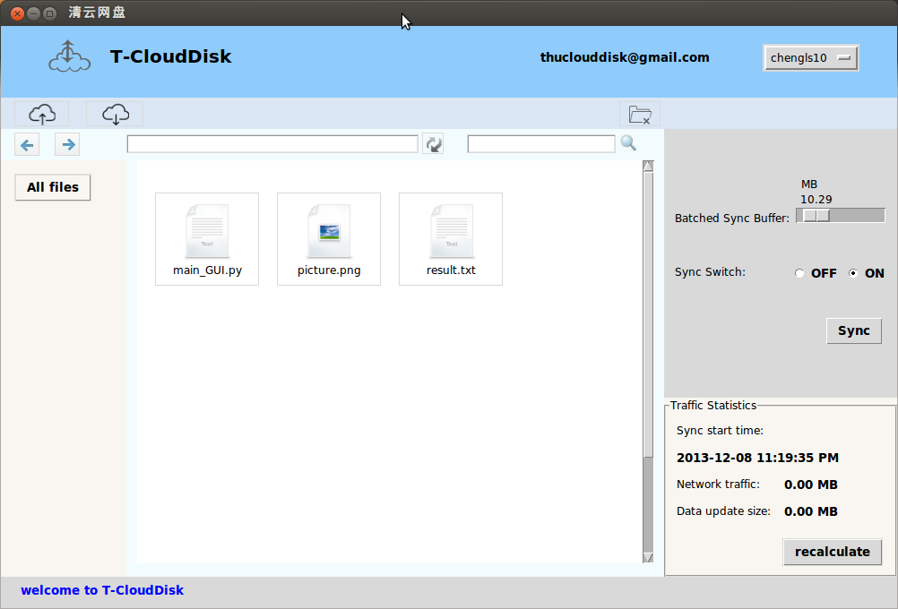
Batched Sync Buffer
Set the buffer size as 10.29 MB
This switch decides whether the sync buffer is effective
Press this button to instantly sync all the files lying in the sync buffer

Slide 17
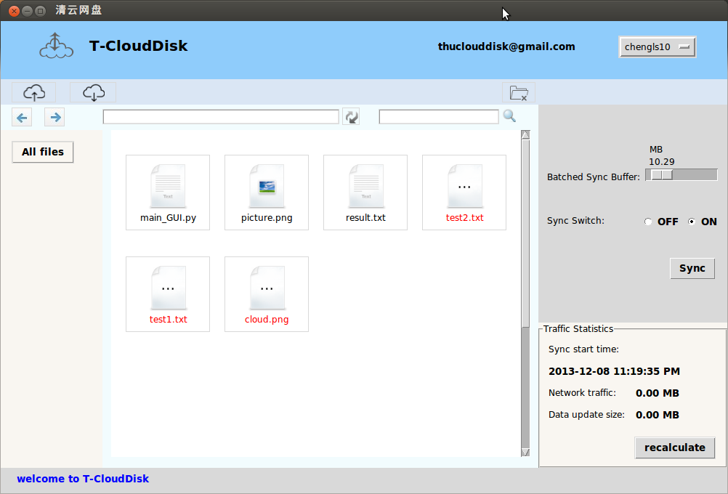
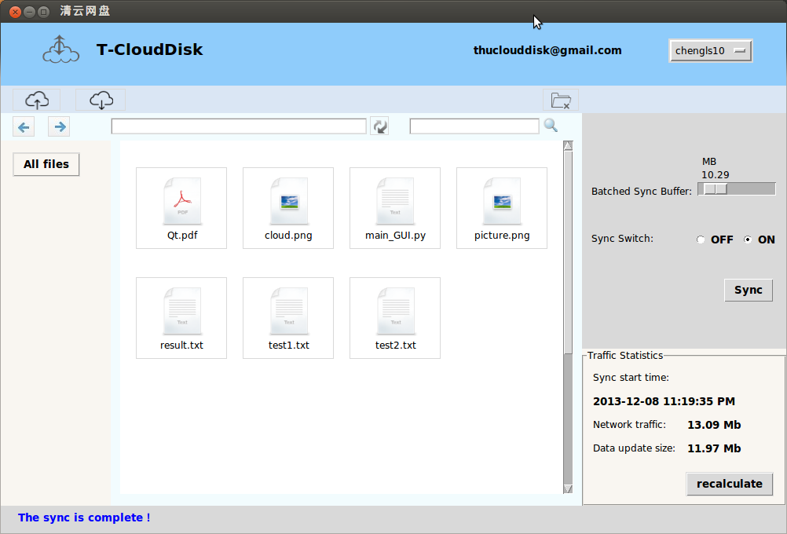
Batched Sync Buffer
Upload three files.
The total size of these files is smaller than 10.29MB.
The file name is red, which means these files are not really uploaded (i.e., buffered).
Then, upload a big file.
Now the total size of these files exceeds 10.29MB.
So all these files are really uploaded to the cloud.

Slide 18

The End

